Slide 1
QA Providers
Archive Tutorial
New File Entry Only
2013
https://go.dhss.ak.local/dsds/archive/SitePages/Home.aspx

Slide 2
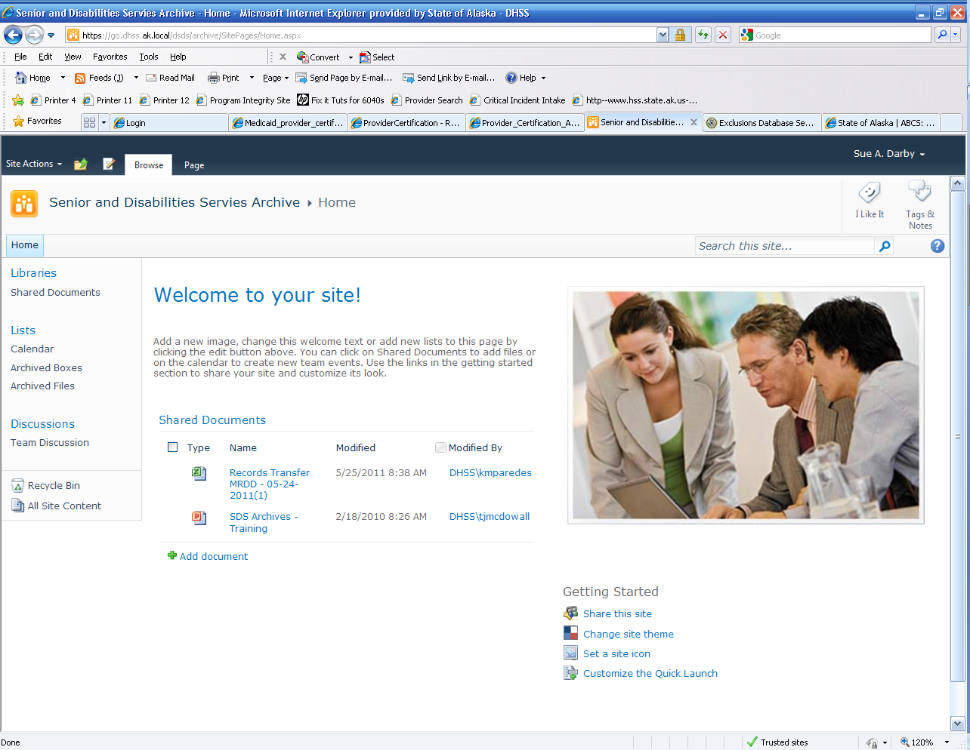
Home Page
Log In
Your home page will look something like this
2. Click on Archived Boxes
2

Slide 3
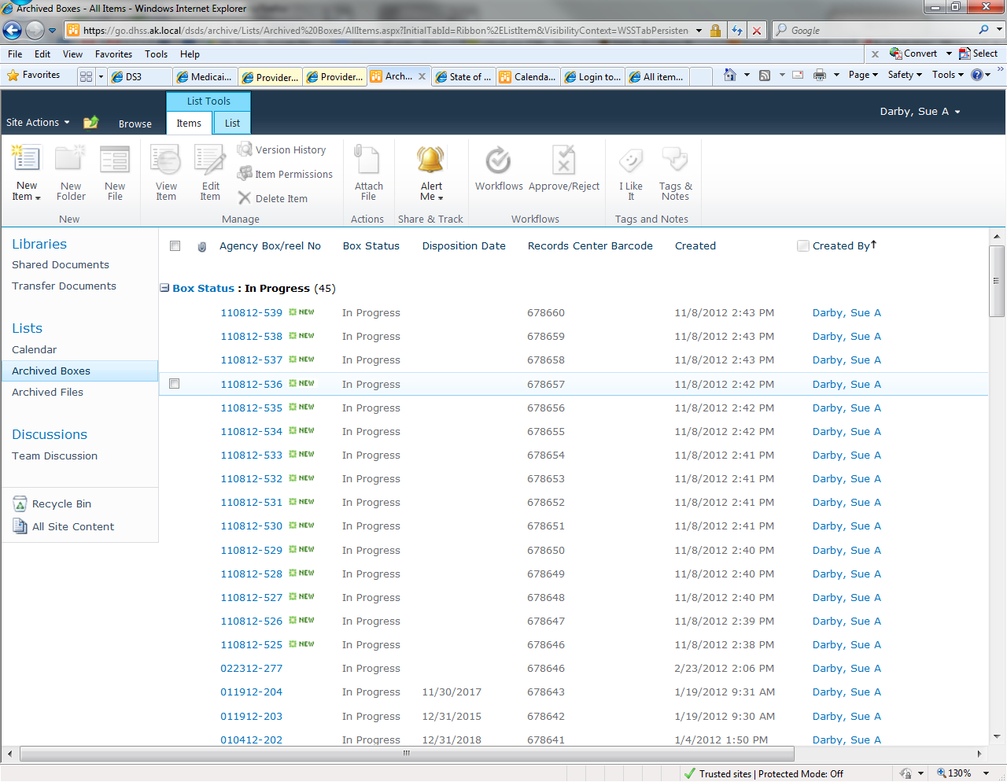
Find your box
Boxes created by Sue Darby
Start with the smallest barcode and move to larger numbers
As you hover over the one you want a small check box will appear, click it to select it
Then click “New File”
4
1
2
3

Slide 4
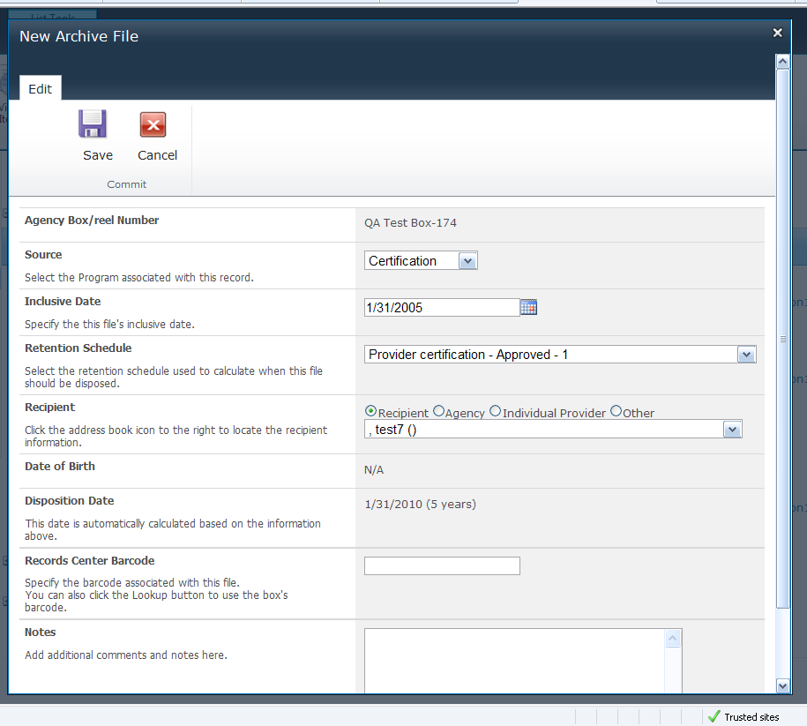
Add a New File to the Box (pt 1)
Source is Certification
Inclusive Date is the date the Agency Closed
Retention Schedule is Provider Certification – Approved – 1 OR Provider Care and Treatment Records - 1 OR Provider Certification (Denied/Revoked)-1 OR Quality Assurance Reviews
This is based on the type of files found in the box you are working on.
1
2
3

Slide 5
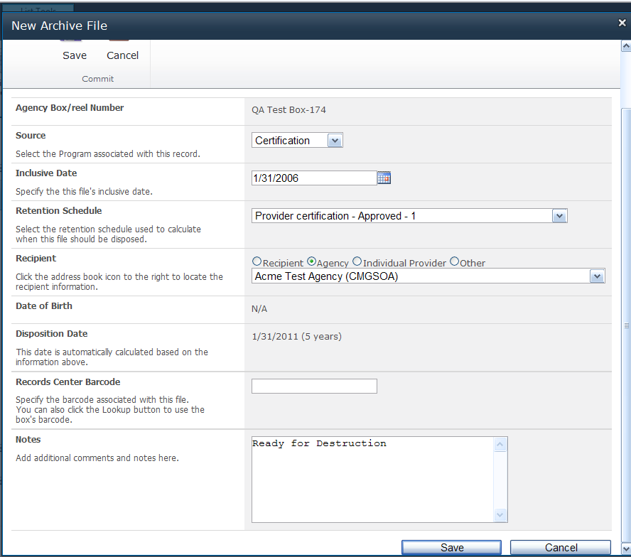
Adding a New File Cont. (pt 2)
Recipient – Choose “Agency” for most providers OR “Individual Provider” for CMs
Disposition Date will be calculated automatically
Records Center Barcode was assigned to the whole box. It will pop up automatically!
Notes – Certification period, handbooks only, audit file etc.
Click Save
1
2
3
4

Slide 6
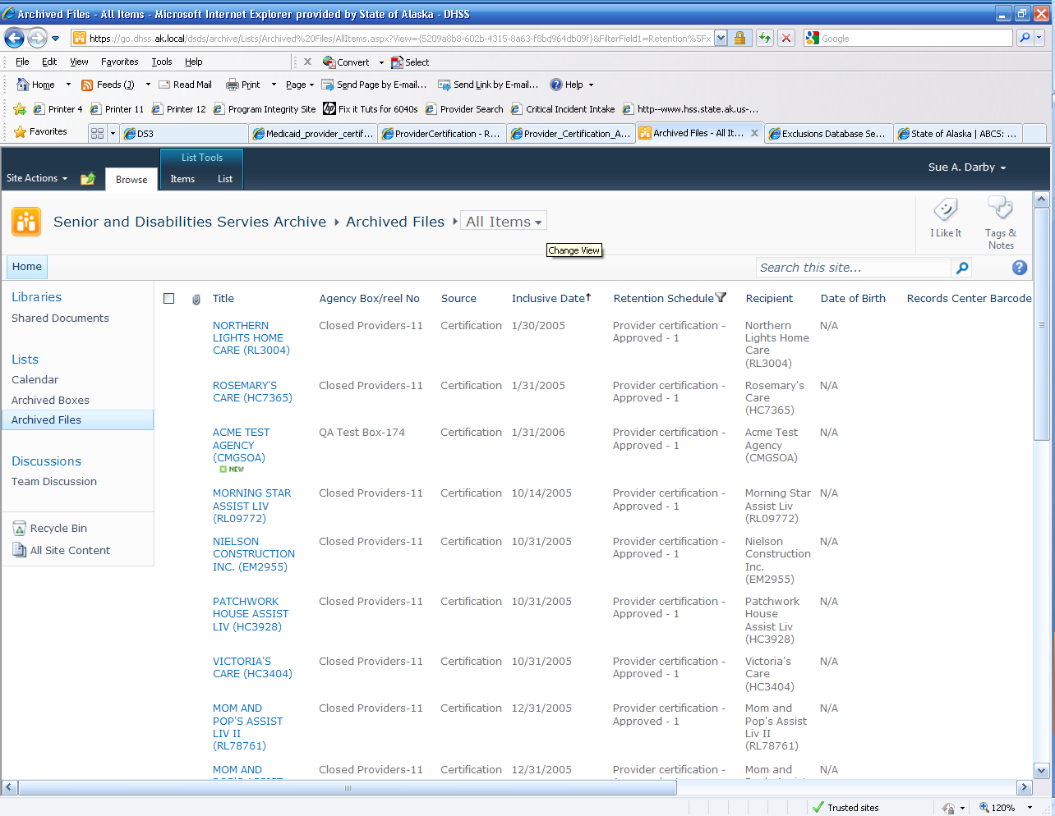
Your single file is in the system!
You will see a long list of various files
From this screen you can sort by title, retention schedule, inclusive dates, barcode etc.

Slide 7

Retrieving a file from the system
From Home click on the Search this site box and type in the name you are looking for

Slide 8
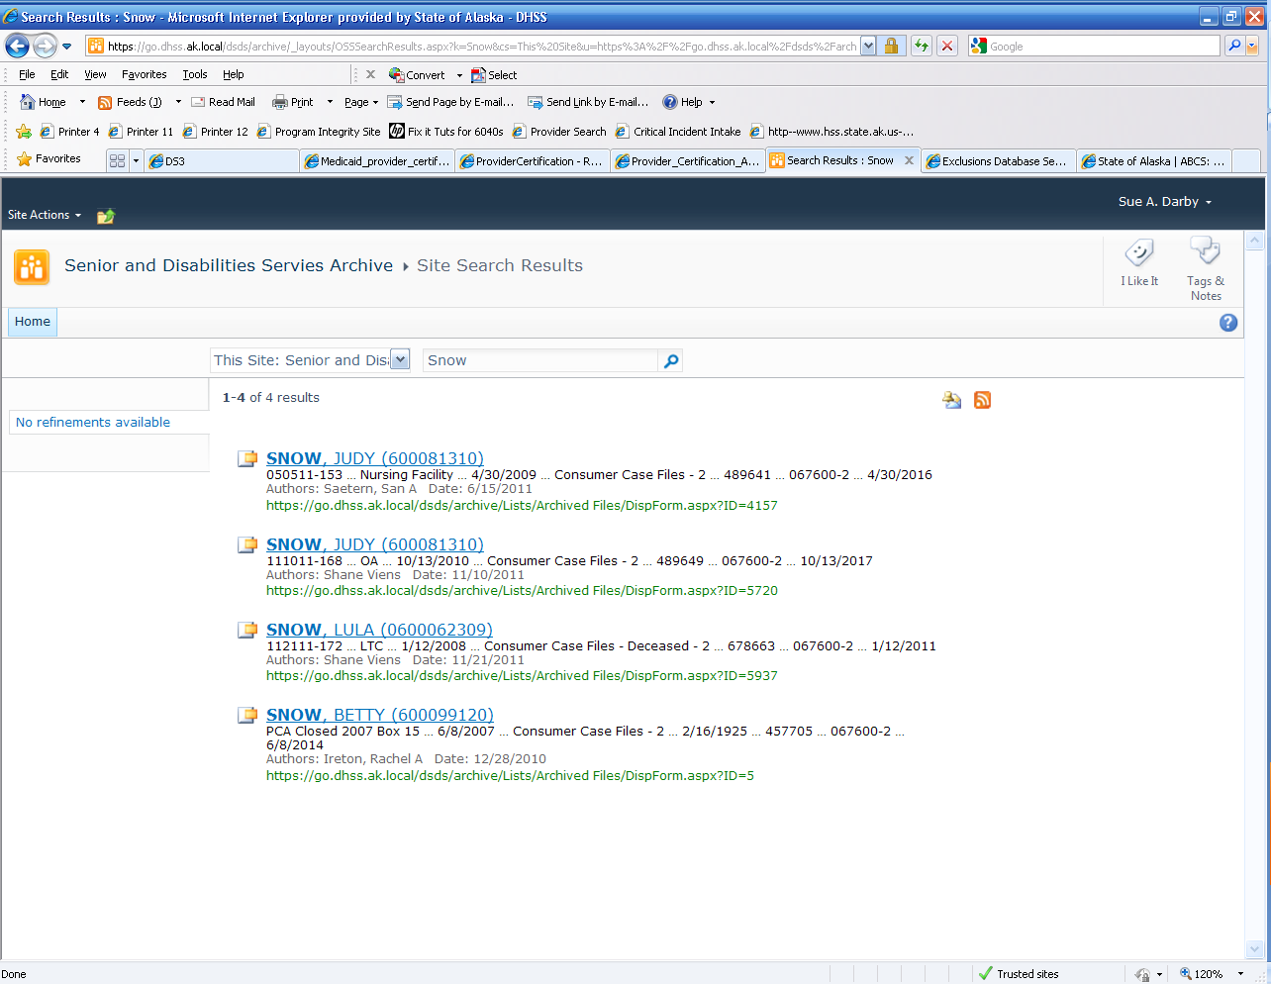
Search Results
Figure out which entry you need and click the entry to gather the information such as the barcode of the box so that the file can be recalled easily!

